Slide 1
Cuda parallelism
Team sirius
Rosario a. Cali Max fainshtein
Joseph pildush mithilan Sivanesan

Slide 2
agenda
Assignment 1
Algorithms
Box Filter
Data Compression
Vehicle Detection
Assignment 2
OpenCV + CUDA = Awesome Box Filter
Assignment 3
OpenCV + more CUDA = Superb Box Filter

Slide 3
Assignment 1 – algorithms
Algorithms implemented serially:
std::sort
Saxpy
Prefix Sum

Slide 4


Assignment 1 – Box filter
An average-of-surrounding-pixel kind of image filtering
Takes 134.68 seconds to process a 4k image on a CPU serially

Slide 5
Assignment 1 – Data compression
An Implementation of the LZW algorithm
Takes 2.66 seconds to process a text file with 535,999 words on a CPU serially
File size is about 5.32 MB

Slide 6
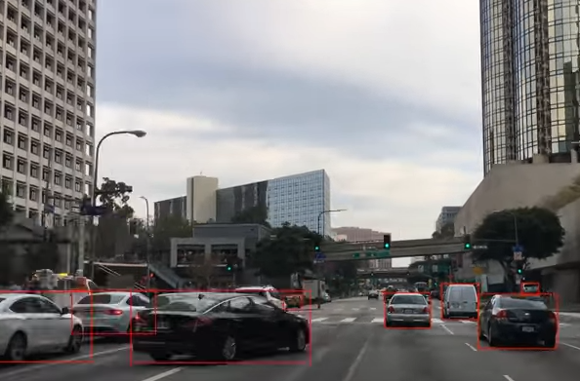
Assignment 1 – Vehicle detection
Detecting vehicles using the DLIB library and a Convolutional Neural Network
Takes 21.01 minutes to process a 10 seconds video

Slide 7
Assignment 2 – awesome box filter
Why the Box Filter problem:
More chances to succeed
Easier to Implement
Great Improvements
Our Approach:
Use OpenCV to open and close images
Create a grid size to cover the whole image
Launch a simple kernel

Slide 8
Assignment 2 – awesome box filter

Slide 9
Assignment 3 – superb box filter
However, there was still a problem…
Here’s how we solved it:
Find the Compute Capability of the GPU
Calculate the number of Threads per Block based on resident threads and blocks
Calculate the number of Blocks based on the image and threads per Block
Use Cuda’s Occupancy Calculator

Slide 10
Shared Memory
Problems:
Each pixel had to access a different set of pixels to calculate the average
The values stored in share memory may not contain region of image required for averaging pixel
The whole image is too large to put into Shared Memory

Slide 11
Assignment 3 – superb box filter

Slide 12
Q&A

Slide 13
Resources and references
Code: https://github.com/RosarioAleCali/DPS915_Final_Project
Wiki: https://wiki.cdot.senecacollege.ca/wiki/Sirius
Course Notes: https://scs.senecac.on.ca/~gpu610/pages/content/index.html
Vehicle Detection: http://blog.dlib.net/2017/08/vehicle-detection-with-dlib-195_27.html
LZW Algorithm: https://codereview.stackexchange.com/questions/86543/simple-lzw-compression-algorithm

